Slide 1
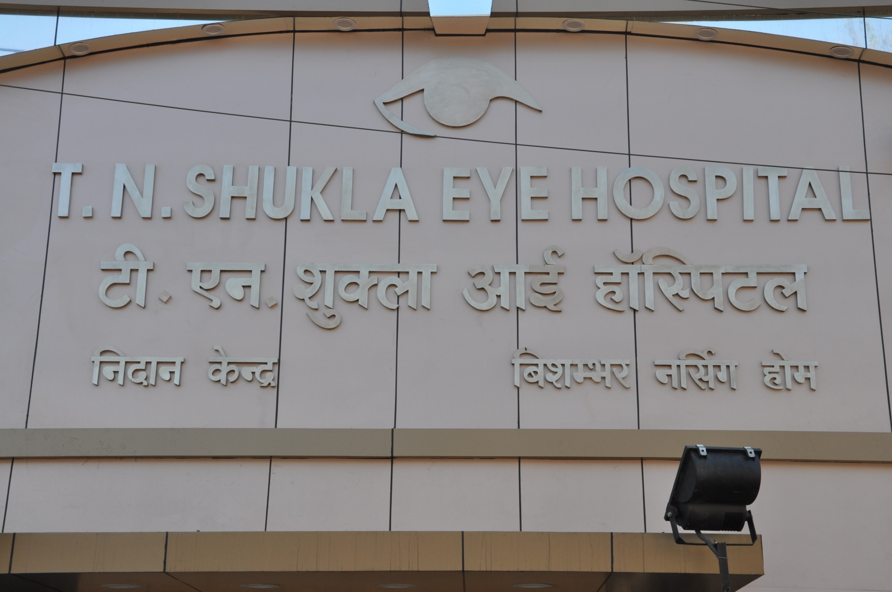
Cystoid Macular Edema Post cataract surgery non resolving C.M.E.
Dr Himanshu Shukla,
T. N. SHUKLA EYE HOSPITAL

Slide 2
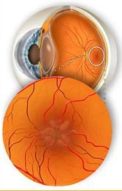
Definition
Accumulation of Fluid in the Outer Plexiform and the Inner Nuclear layer of the retina.
There is formation of Fluid filled cyst like spaces in the central macula.
Usually associated with breach in the Inner Blood Retinal Barrier.

Slide 3
Basic Pathology

Slide 4
“Progression”

Slide 5
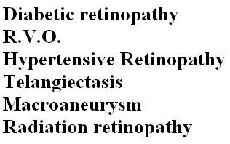
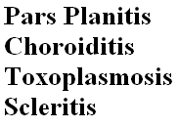

Slide 6
Miscellaneous Causes
Retinal Dystrophies:
Retinitis pigmentosa
Gyrate Atrophy
Hereditary CME
SRNVM
Retinal And Choroid Tumors
Drug Induced
Topical Adrenaline
Topical Prostaglandin analogs
Systemic Nicotinic acid

Slide 7
IRVINE-GASS SYNDROME
In 1955 Prof. Irvine described “ Macular changes occurring in patients after cataract surgery with loss of Best corrected visual acuity”
In 1966 Dr. Gass and Norton described “ These changes are Cystic spaces in macula” and termed “Irvine- Gass Syndrome”.
Later through studies it was described as the most common cause of Visual loss after an uneventful cataract surgery.

Slide 8
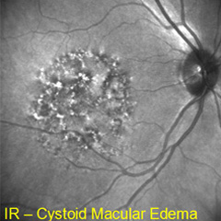
Post Operative C.M.E
Event following an Uncomplicated Cataract Surgery.
Spontaneous resolution does occur.
Peak incidence are at 5-10 weeks postop.

Slide 9
RISK FACTOR ASSOCIATED WITH IRVINE GASS SYNDROME
P.C.R. (With more chances with Vitreous loss).
Vitreous in A/C.
Aphakia.
Unstable diabetic maculopathy.
H/O CME in contra lateral eye.
Secondary IOL’s
Early YAG ( < 6 Months Post op).
Topical Prostaglandin Analogs

Slide 10
Clinical Presentation
Blurring of Vision. ( Watery Vision)
Usually after 5-10 Weeks post operative.

Slide 11
Clinical Presentation Irvine Gass

Slide 12
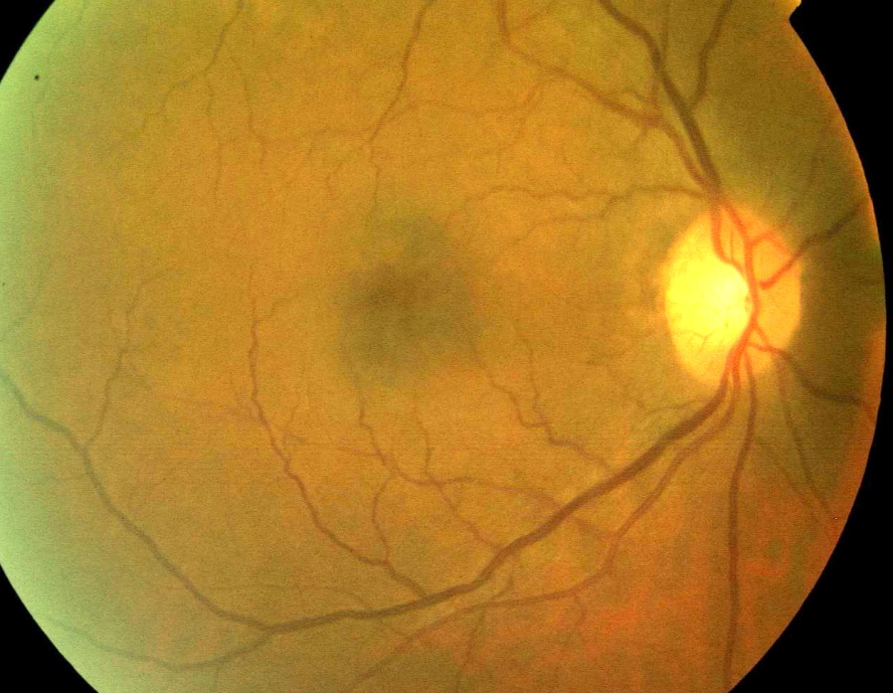
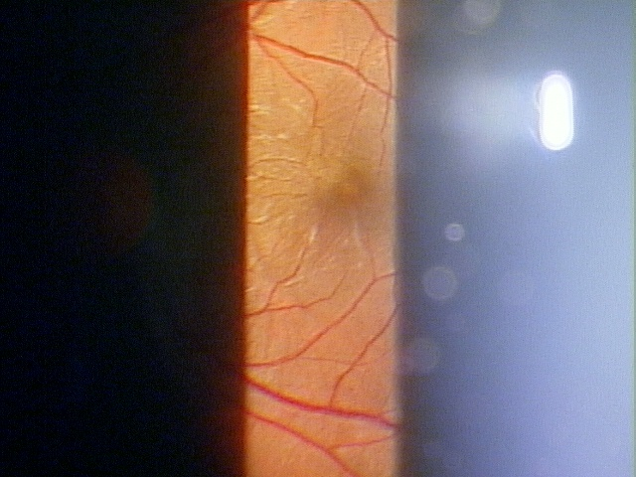
Fundus Examination (90D or Fundus Photo)
Loss of Foveal reflex in an otherwise normal looking macula.
Retinal Thickening
Yellow Spot at fovea
“Cystic spaces seen at macula”

Slide 13
Extra macula Finding in Chronic Severe Irvine Gass
Some Degree of Optic nerve head swelling with mild congestion reduced cup size.
Changes are best appreciated when compared with the other eye disc findings.
Media Haze with Vitritis like picture

Slide 14
Diagnostic test for C.M.E.

Slide 15
Fundus Fluorescein Angiography
Pre-OCT era: Test of choice in cases post op. with reduced visual acuity and no clear Fundus findings.
Also helped in finding any other etiological cause associated with C.M.E
“Angiographic macular edema”, macular edema visible only angiographically.

Slide 16
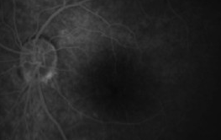
Fundus Fluorescein Angiography
Notes:
HI

Slide 17
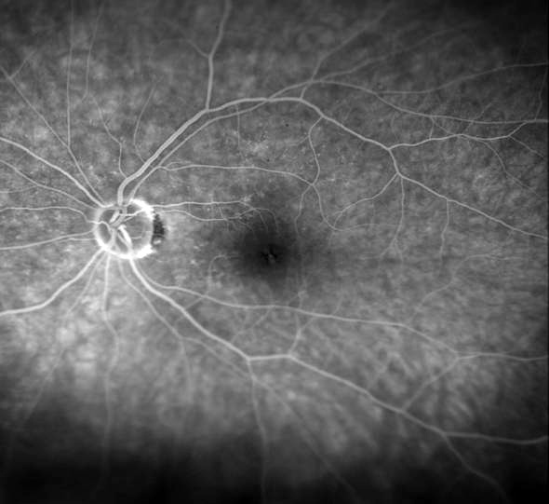
Minimal C.M.E

Slide 18
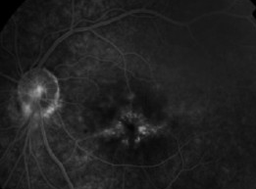
Moderate Angiographic C.M.E.

Slide 19
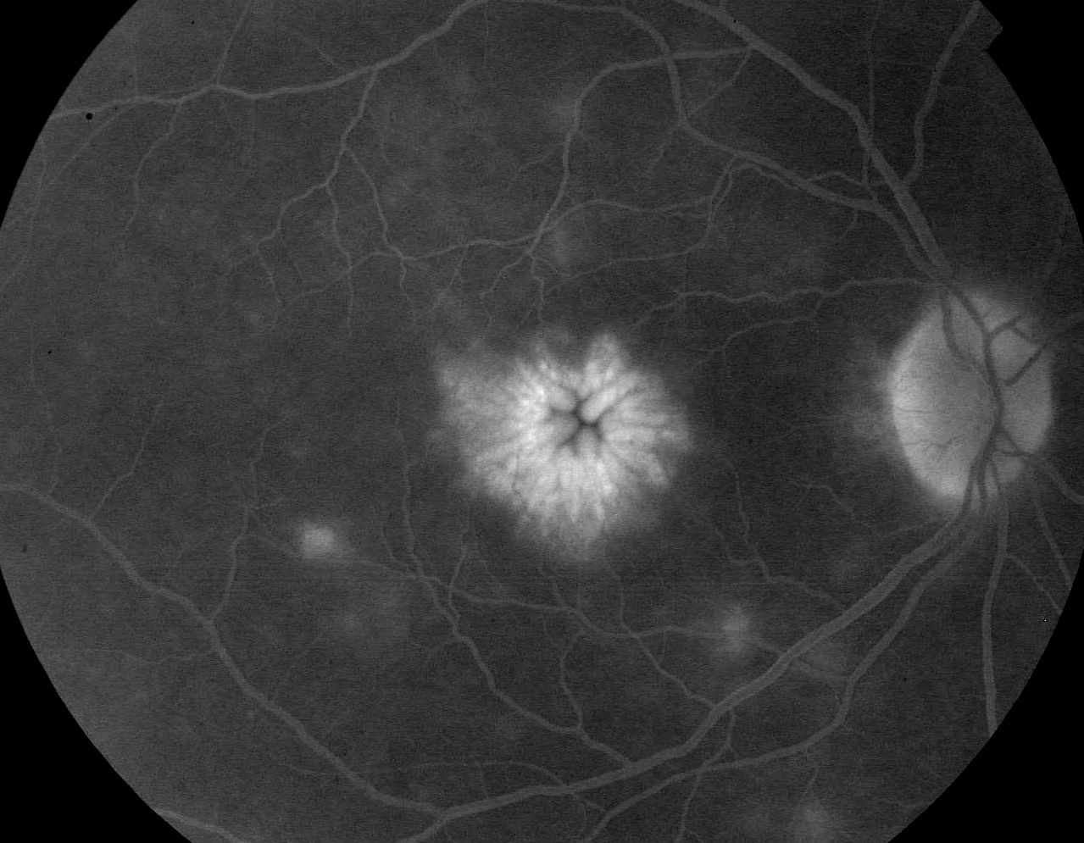
Typical “Flower Petal Appearance”

Slide 20
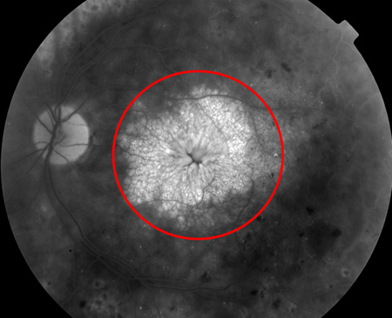
Massive C.M.E. with Associated pathologies

Slide 21
Points Regarding FFA
According to “Gass . Et al”
There is significant correlation between visual acuity and area found with Cystoid changes.
There is no correlation between V/A and distance the cyst from FAZ.

Slide 22
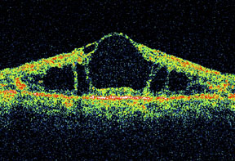
Optical Coherence Tomography

Slide 23
Mild Irvine Gass Syndrome

Slide 24
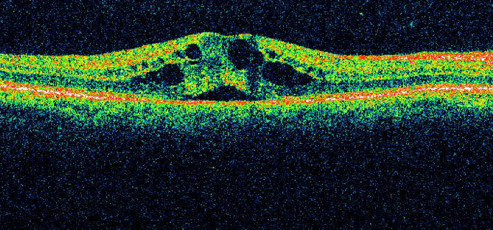
Moderate Irvine Gass Finding

Slide 25
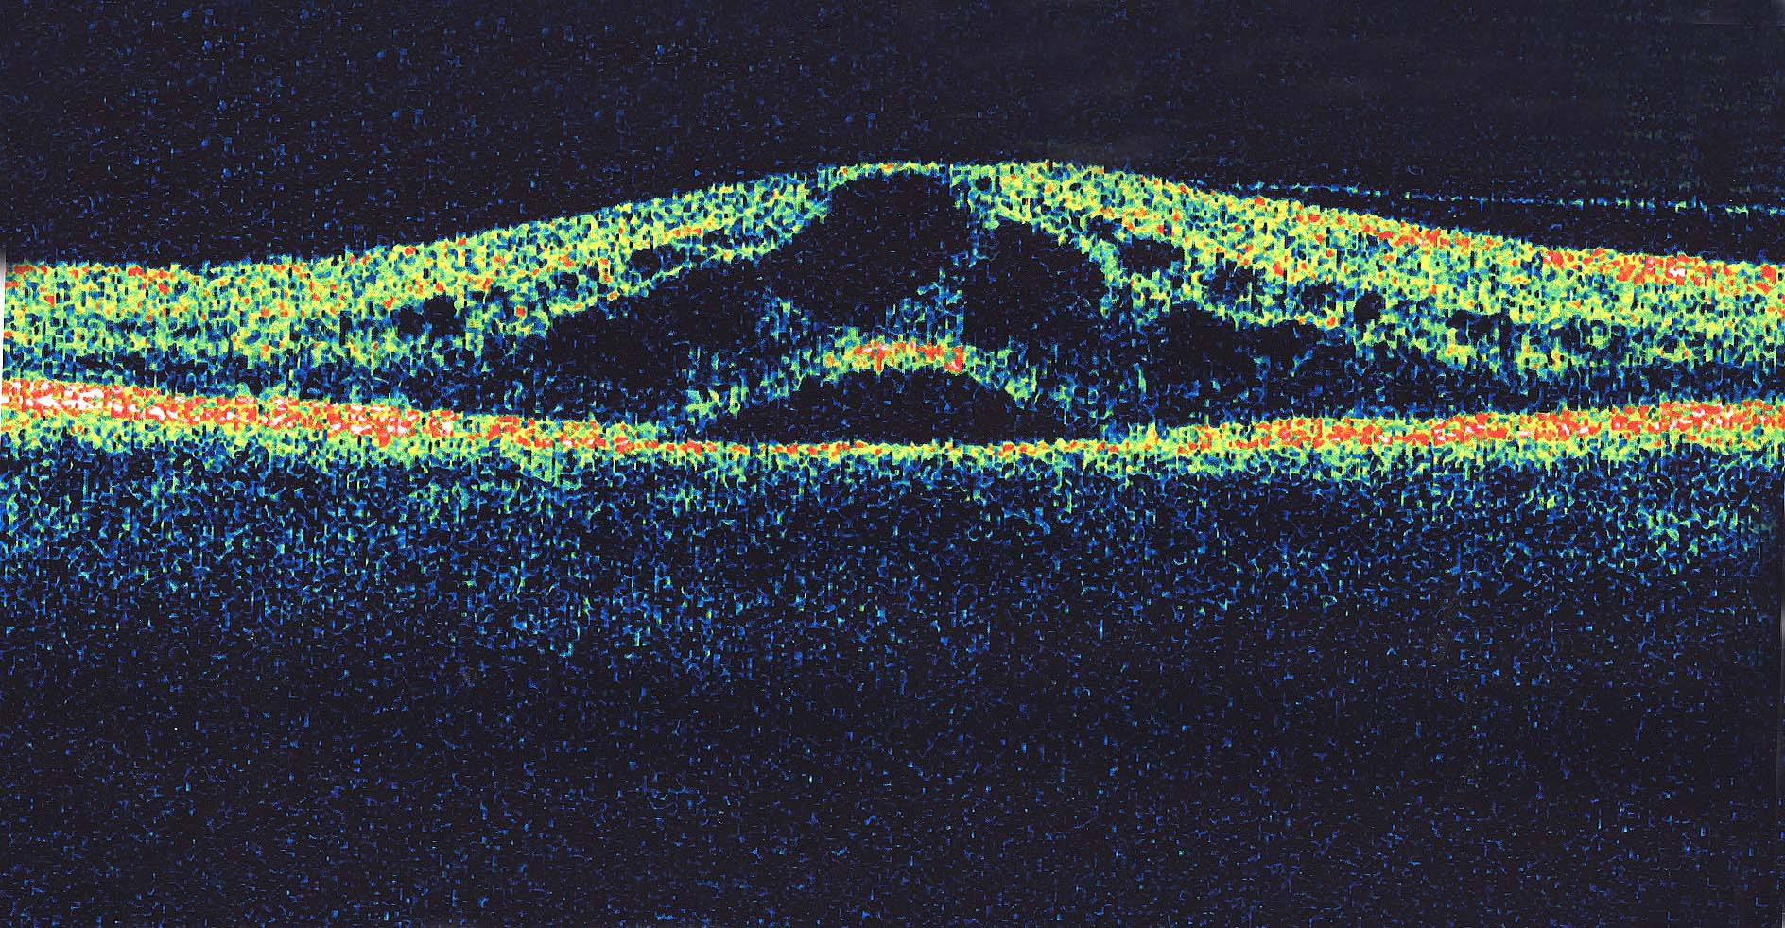
OCT in Severe Irvine Gass Syndrome

Slide 26
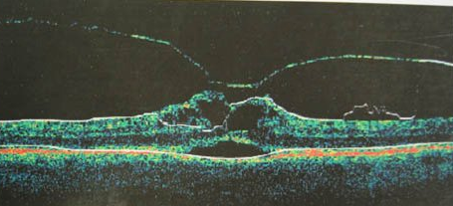
CME with V.M.T.S

Slide 27
Treatment Option For “Irvine Gass Syndrome”

Slide 28
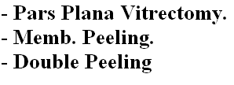
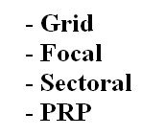
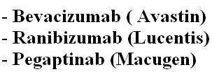
Treatment For Secondary CME

Slide 29
Moderate C.M.E Available Topical NSAID’s
Ketorolac 0.5%
Ketorolac 0.4% (with Antibiotic combination)
Diclofenac 0.1%
Nepafenac 0.1%
Bromfenac 0.09%(with Antibiotic combination)

Slide 30
Points Regarding Ketorolac
Prophylactic use of Ketorolac 0.5% after cataract surgery reduces chances of Pseudophakic CME.
Most of the Multicenter R.C.C.T. are on 0.5% Ketorolac.
Although it has been shown that 0.4% is as effective as 0.5% drug in Q.I.D dosage schedule.

Slide 31
Topical KETOROLAC
Many Pilot studies and Multicentre studies show Ketorolac to be:
Effective in reducing post operative CME.
Probable Synergistic with Topical Steroids.
Also working Effectively in combination with antibiotic.
More effective in Acute CME than in Chronic once.

Slide 32
Nepafenac and Bromfenac
Prophylactic use of Nepafenac 0.1% TDS reduces chances of Clinical Pseudophakic CME.
Still, Nepafenac and Bromfenac are FDA approved for Postoperative Inflammation control but not Prophylactically for Pseudophakic CME.
Effective in Secondary CME’s in venous occlusions and DME.

Slide 33
Nepafenac and Bromfenac
There is no current R.C.C.T to show Superiority of any one over the other.
The advantage of the above Quoted drugs:
lesser dosage schedule
Comparatively better patients response

Slide 34
Severe Pseudophakic CME
Blurred Vision.
OCT:
C.F.T > 400 um.
Gross Cystic Spaces.
Subretinal Fluid

Slide 35
Severe OR Refractive Pseudophakic CME & Intravitreal Triamcinolone
IVTA leads to visual improvement in these patients.
The improvement is usually:
Visual improvement with BCVA > 2 ETDRS lines
OCT : reduced CFT and normal Contour
Resolved Angiographic CME
Dosage:
4mg in 0.1ml.
Currently used: 2mg in 0.05 ml
Rarely these patients require repeat injection after 6-8 months.

Slide 36
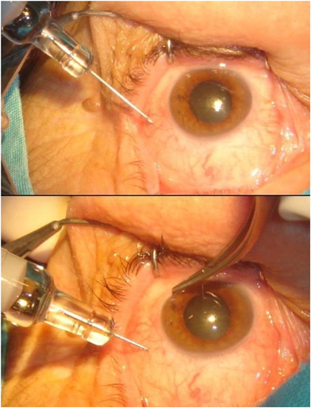
Intravitreal Triamcinolone Technique
Aseptic precautions.
2mg in 0.05 ml taken in 1ml syringe.
26/30 Gauge needle.
Carefully stabilize globe
Injected 3.5 to 4 mm from limbus.
Needle is withdrawn
Area pressed with cotton bud.

Slide 37
Literature Reported Complication of Intravitreal Triamcinolone
Raised IOP. ( seen more with high dose).
Floater ( since particle are appreciated)
Lens Touch.
Cataract Formation (Not to worry in Pseudophakic).
Pain after injection
Endophthalmitis
Vitreous Hemorrhage
Retinal detachment

Slide 38
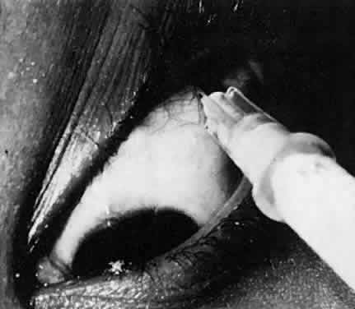
Severe or Refractive CME and PST
Their have been reports that:
Posterior Subtenon injection of Triamcinolone improves vision and reduces CFT in patient with Chronic non resolving Pseudophakic CME.
Most of the studies now take into consideration Intravitreal injection of steroids for treatment of Chronic Non resolving CME.
Complication:
Globe perforation.
Raised IOP.
Improper injection module.
Concern for dosage.

Slide 39
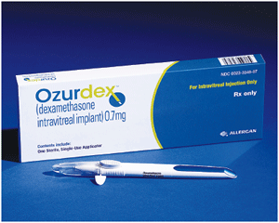
Ozurdex Implant
Long acting
Dexamethasone 0.7mg.
Good for conditions requiring repeated IVSteroid.
Effect need to be proven

Slide 40
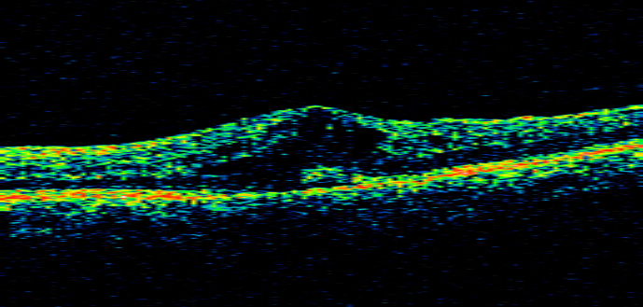
Patient Day 1 OCT with 20/100.

Slide 41
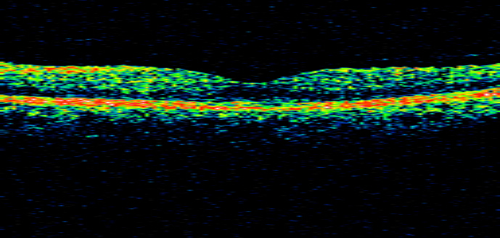
Day 30 After Intravitreal Triamcinolone

Slide 42
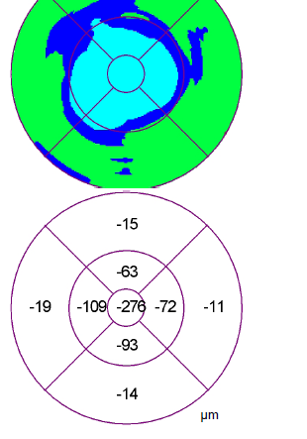
Improvement Seen
Increase in BCVA from 20/100 to 20/20.
Reduced C.F.T.
-276 um reduction in C.F.T.

Slide 43
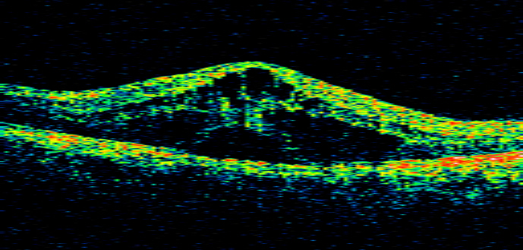
Second Report of Refractory Pseudophakic CME

Slide 44
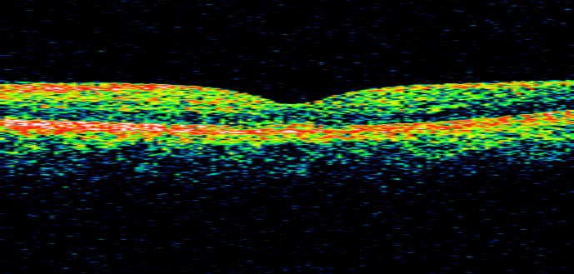
Day 26 post IVTA

Slide 45
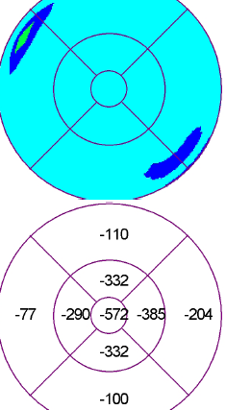
Improved
BCVA 20/100 on day 1 improved to 20/30 day 26.
CFT decreased by 572um.
Normal Foveal Morphology achieved.

Slide 46
Topical Medication post injection
We continued either Combination drops with Ketorolac 0.4% OR Bromfenac 0.09% OR Nepafenac 0.1% in all cases of Refractive CME who where treated with IVTA.
Mostly the drops where preferred based on what medication patient already had with him.
Most cases showed improvement on serial OCT and visual recovery. The former occurring before in time.

Slide 47
Pars Plana Vitrectomy for Refractory Pseudophakic CME
Improvement occurs in selected cases.
Indications:
Taut posterior Hyaloid.
E.R.M.
Complicated Pseudophakic.

Slide 48
Other Treatment Tried
Oral Acetazolamide:
Risk of adverse effect are more.
Non of the trails show their benefit
Oral Steroid:
Effective in Uveitis CME’s.
Primary Pseudophakic CME: No role
Intravitreal Bevacizumab (Avastin):
Few R.C.C.T show their benefit in Refractory CME.
Not Proven

Slide 49
Summary
Pseudophakic CME occur even in uneventful Cataract surgery. Although incidence increase with intraoperative complication.
Usually these occur 5-10 weeks postop. Thus the patient has good vision immediate postoperatively followed by reduced vision later.
Most of these cases respond to topical NSAID’s. The choice of drugs are multiple and NO superiority has been proven of any available drug type.
Cases should be investigated and treated depending upon their pathological status.

Slide 50
Intravitreal injection of Triamcinolone does improve visual acuity and anatomic recovery is seen even in chronic cases. Rarely, repeat injections 6-8 months later.
Intravitreal injection of Anti VEGF : May be useful in co-existing pathologies or refractory CME.
Pars Plana Vitrectomy with or without Membrane peeling, in indicated case.

Slide 51
Thank You

